Slide 1
Beneath the abstraction

Slide 2
Index
Relate the continuous to discrete
Logic Level
Noise Margins
DC Transfer Characteristics
Logic families
Implementing Logic Gates
Gears and vacuum tubes
The Revolution of Integration
Moore Law
Electron devices
Silicon
Semiconductors
p-n junction
Diode
MOS Transistors
Logic gates from transistor
NOT, NAND, NOR

Slide 3
Relate the continuous to discrete
A digital system uses discrete-valued variables
However, the variables are represented by continuous physical quantities
the voltage on a wire, the position of a gear, or the level of fluid in a cylinder
The designer must choose a way to relate the continuous value to the discrete value
Consider representing a binary signal A with a voltage on a wire
let 0 volts (V) indicate A=0 and 5V indicate A=1
any real system must tolerate some noise
so 4.97V probably can to be interpreted as A=1 as well
but what about 4.3V? or 2.8V? or 2.5V?

Slide 4
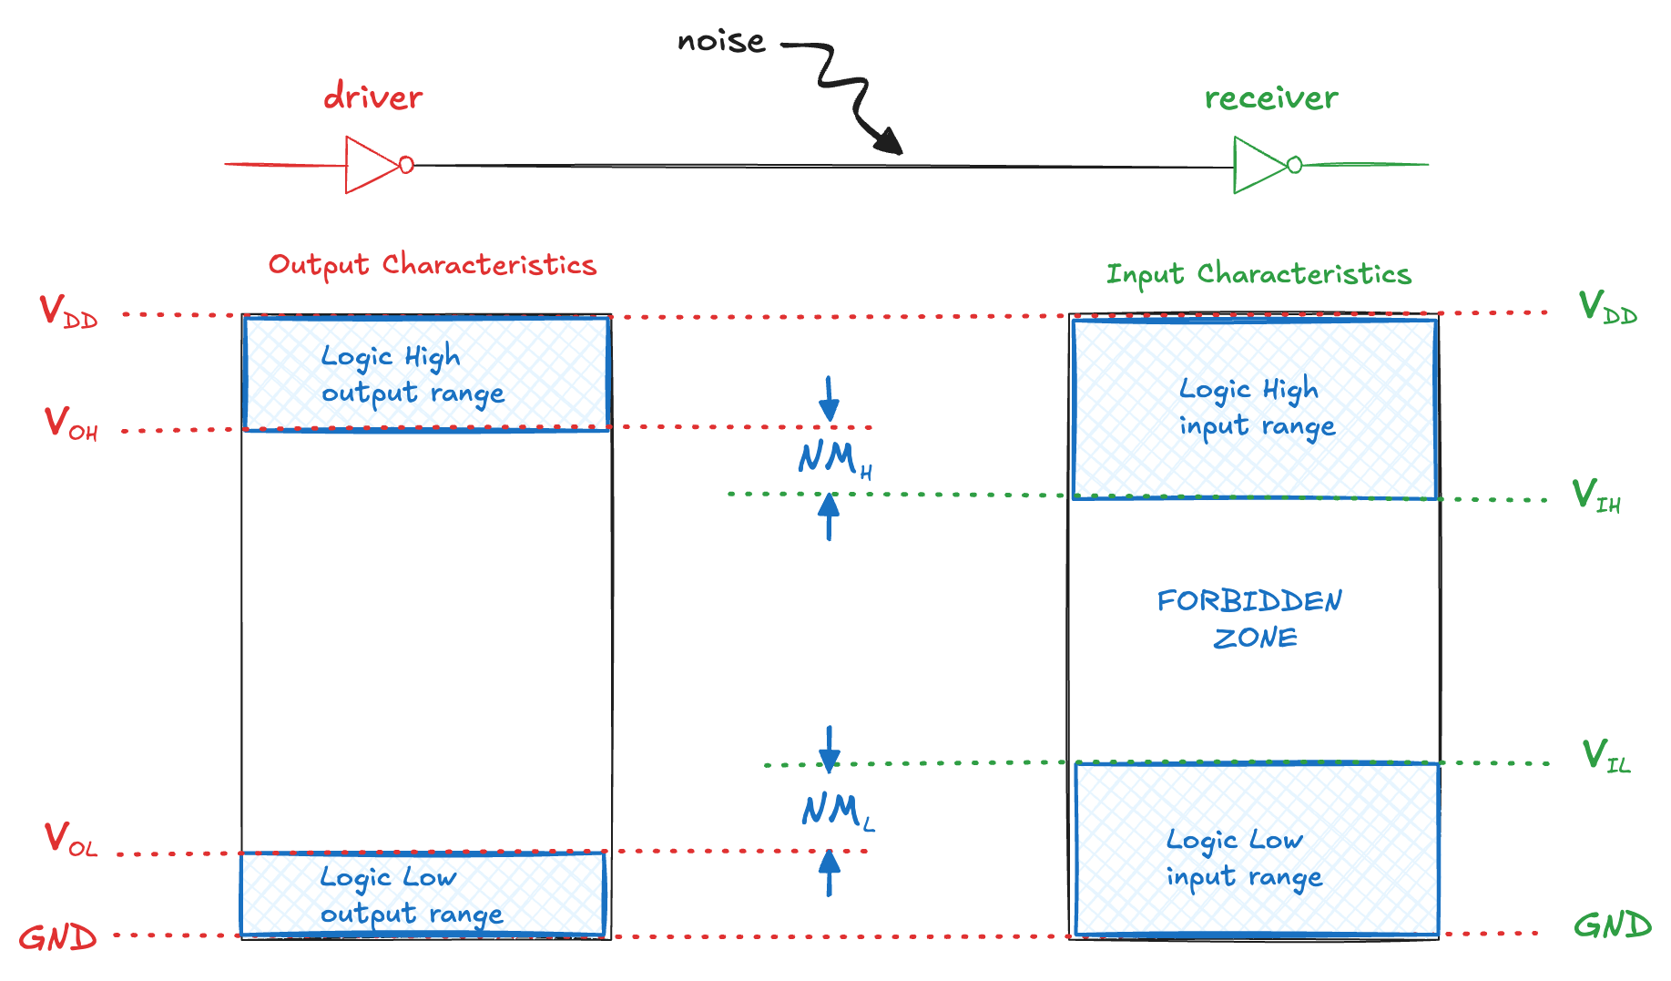
Logic Level and Noise Margins (1)
The lowest voltage is 0V, also called ground or GND
The highest voltage comes from the power supply and is called VDD
The mapping is done by defining logic levels
The noise margins are the amount of noise that could be added to an output such that the signal can still be interpreted as a valid input
NM_{L} = V_{IL} – V_{OL}, NM_{H} = V_{OH} – V_{IH}

Slide 5
Logic Level and Noise Margins (2)
Consider the following circuit:
V_{O1} is the output voltage of inverter I₁
V_{I2} is the input voltage of inverter I₂
Both inverters have the following characteristics
V_{DD}=5V, V_{IL}=1.35V, V_{IH}=3.15V, V_{OL}=0.33V, V_{OH}=3.84V
What are the inverter low and high noise margins?
NM_{L} = V_{IL} – V_{OL} = 1.35V − 0.33V = 1.02V
NM_{H} = V_{OH} − V_{IH} = 3.84V − 3.15V = 0.69V
Can the circuit tolerate 1V of noise between V_{O1} and V_{I2}?
it can tolerate the noise when the output is LOW (NM_{L} = 1.02 V)
but not when the output is HIGH (NM_{H} = 0.69V)
How can we define those values?

Slide 6
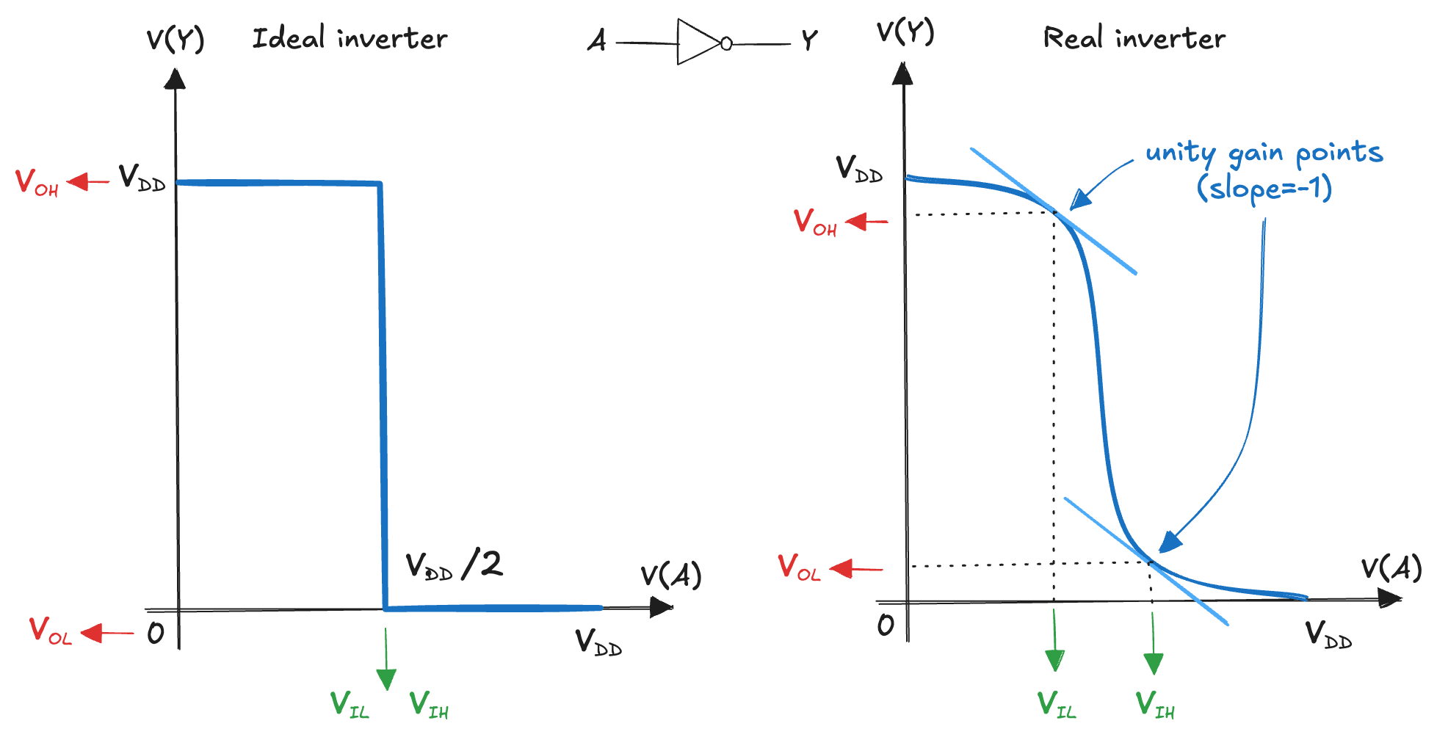
DC Transfer Characteristics
The output voltage as a function of the input voltage
To understand the limits of the digital abstraction, we must delve into the analog behaviour of a gate

Slide 7
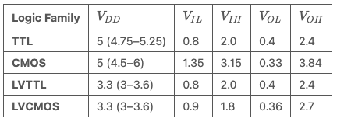
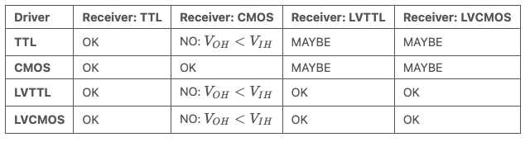
Logic families
Static discipline: if inputs are logically valid, outputs will also be valid
ensures simplicity, robustness, and scalability
like a grammar: valid “words” (gates) → valid “sentences” (circuits)
Gates must use compatible logic levels → grouped into logic families
Compatibility:
within a family: gates ”snap together” like Lego
across families requires caution or interfacing
Trend: shift from 5V → 3.3V → 2.5V → 1.8V → lower for reduced power

Slide 8
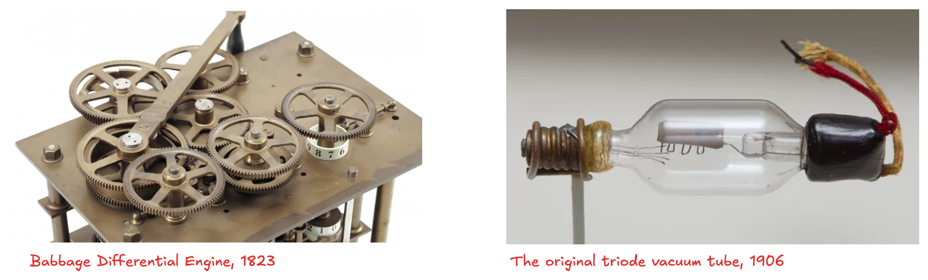
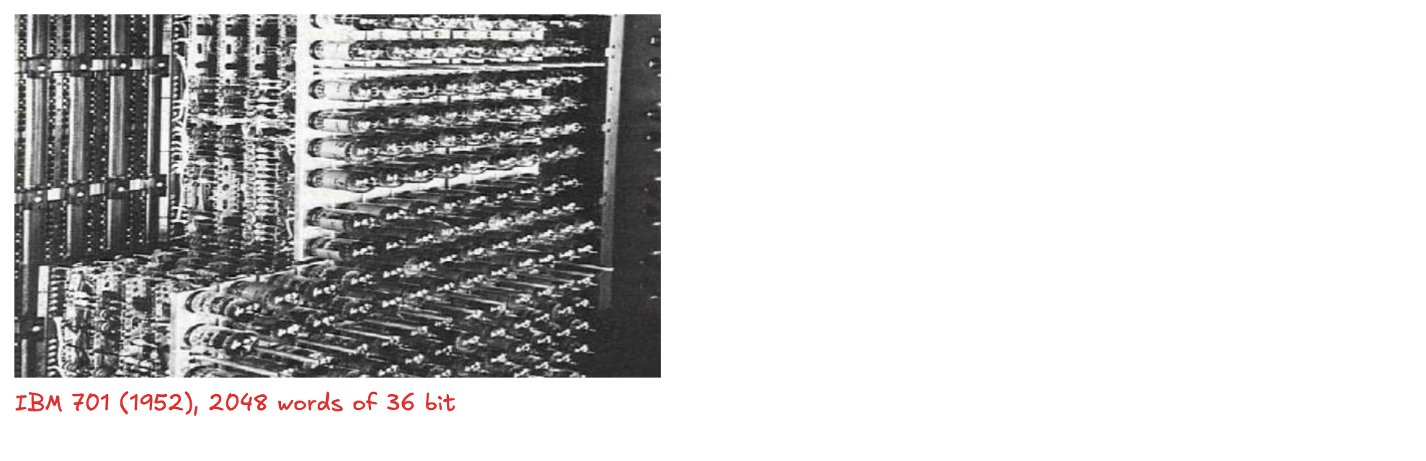
Implementing Logic Gates
How can we implement logic gates?
Bbabbage’s Analytical Engine was built from gears
early electrical computers used vacuum tubes
What’s the problem? → large, fragile, power-hungry, and unreliable

Slide 9
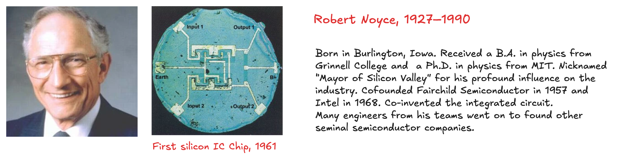
The Revolution of Integration
Modern digital systems use transistors
electrically controlled switches that turn ON or OFF when a voltage or current is applied to a control terminal
cheap, small, and reliable
Revolution: the ability to integrate large numbers of transistors onto a single chip
1958, Jack Kilby at Texas Instruments built the first integrated circuit
1959: Robert Noyce at Fairchild Semiconductor patented a method for interconnecting multiple transistors on a single silicon chip
at the time, transistors cost about $10 each; after some decades of advances, we can pack roughly one billion MOS onto a 1 cm² chip of silicon, and each transistor cost less than 10 micro-cents

Slide 10
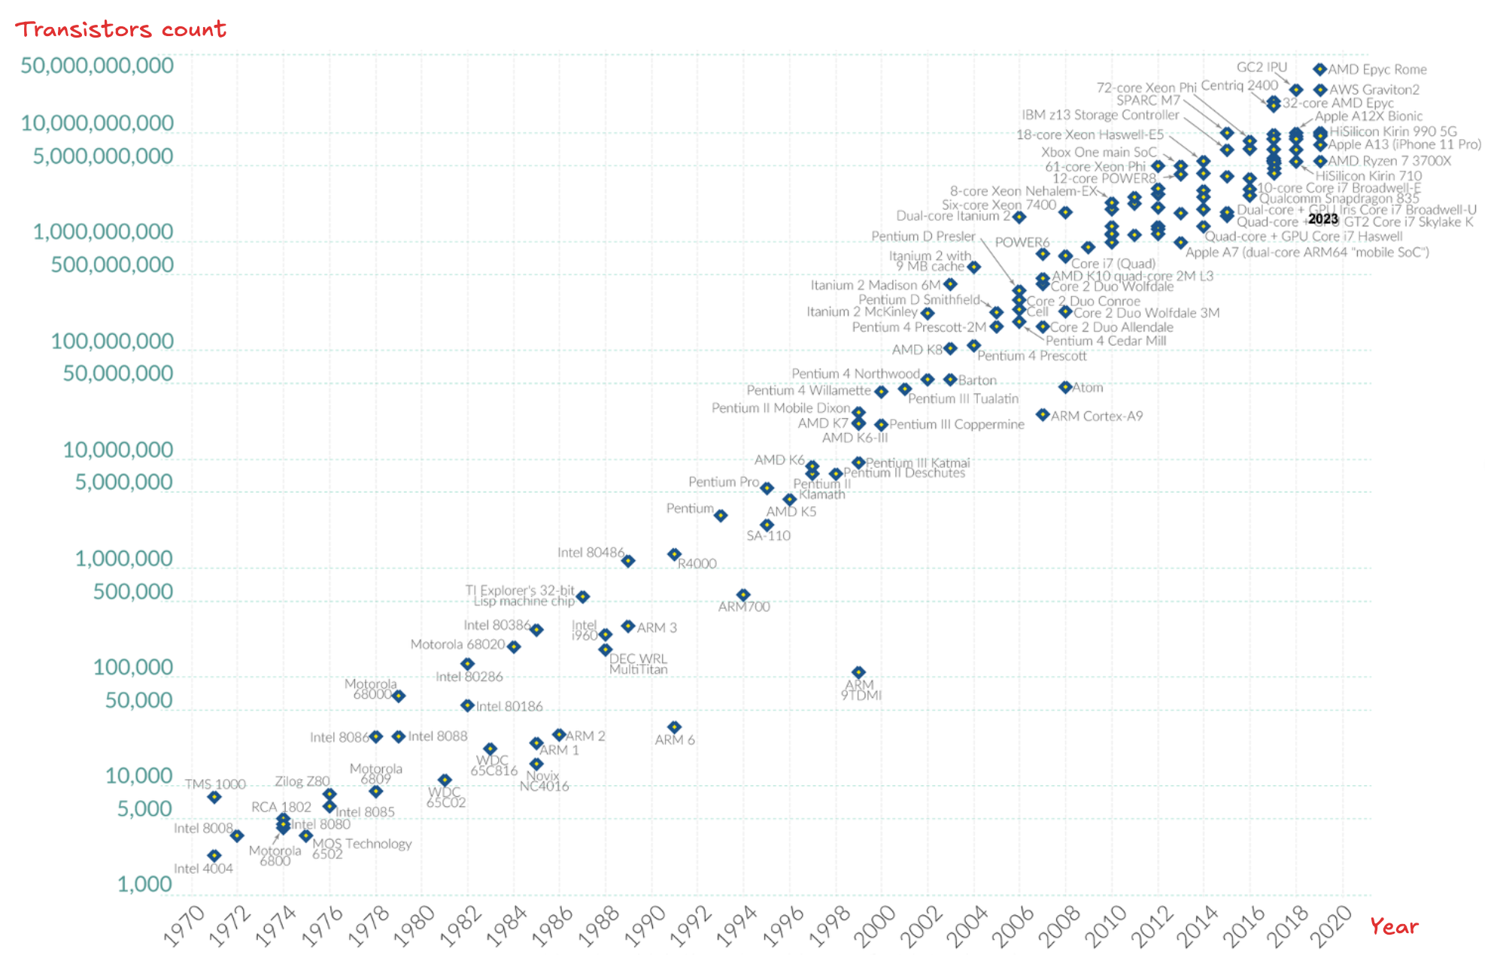
Moore Law
The number of transistors on an integrated circuit was doubling roughly every two years.

Slide 11
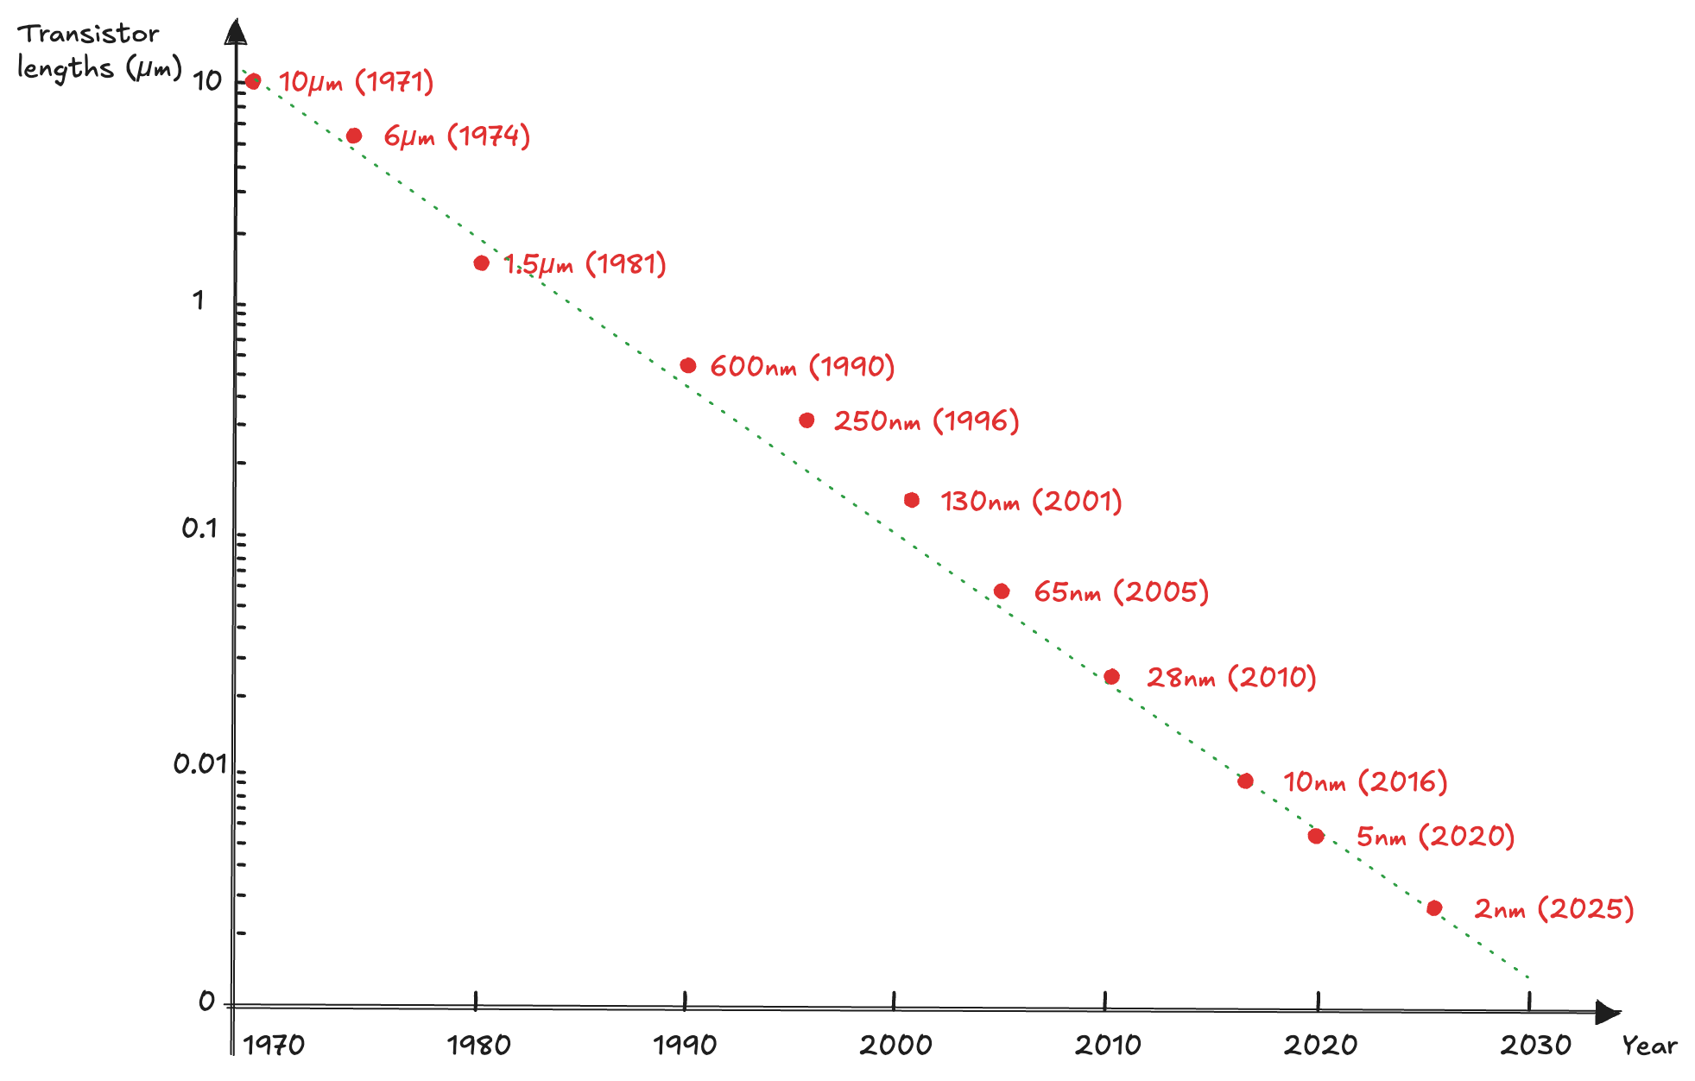
Transistor scaling

Slide 12
Beyond Moore
Exponential growth in transistor counts drove higher speed, memory, and lower cost → fuelled the Information Age
Scaling is slowing (last decade)
atomic-scale barriers (quantum effects, heat, manufacturing, materials)
Strategies Beyond Scaling:
Multi-core processors → parallelism instead of faster clocks
3D integration → stacking circuits to reduce delay and increase density
New paradigms:
New materials (graphene, nanotubes, 2D semiconductors)
Specialized accelerators (GPUs, AI chips)
Quantum computing → beyond classical logic

Slide 13
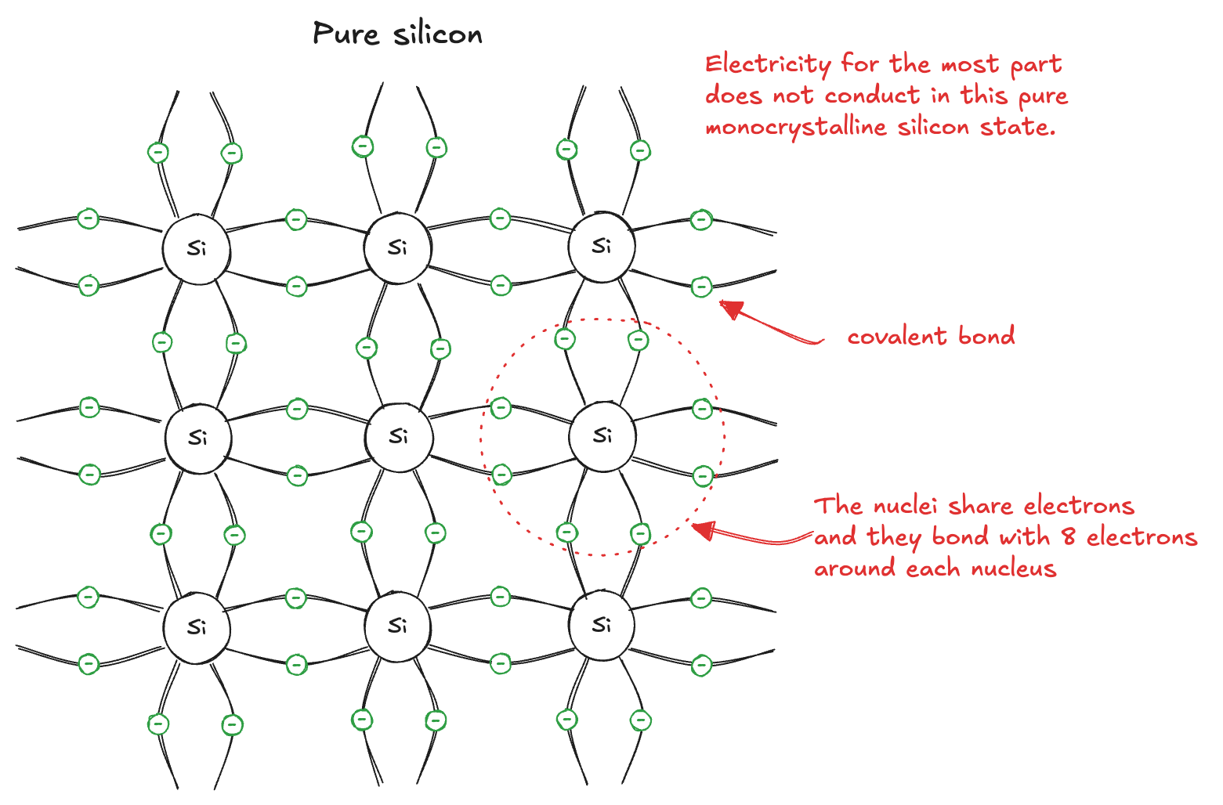
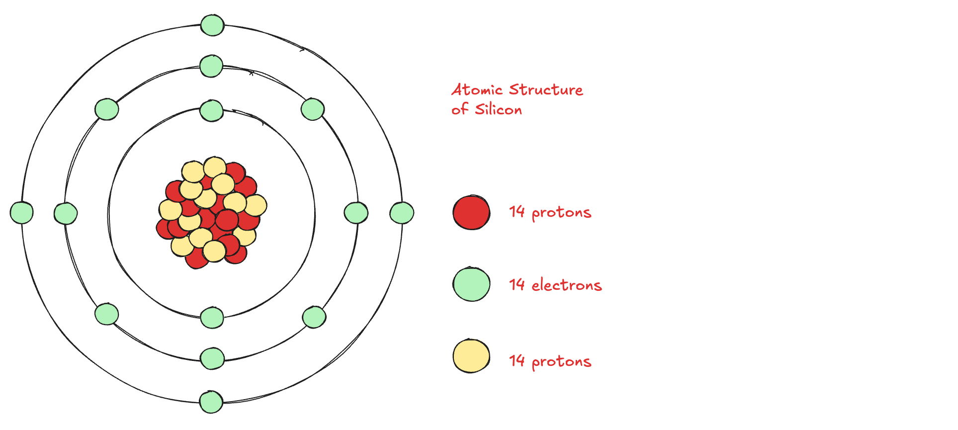
Silicon
Modern transistors use MOS technology based on silicon (Si)
Silicon has 4 valence electrons, forming covalent bonds → stable crystal lattice
Pure silicon = poor conductor (no free carriers)
Doping: tuning conductivity
n-type (e.g. As) → extra electron → free negative charge
p-type (e.g. B) → missing electron → hole behaves like positive charge
➡️ By adjusting dopants, silicon’s conductivity can vary over many orders of magnitude → basis for diodes and transistors

Slide 14
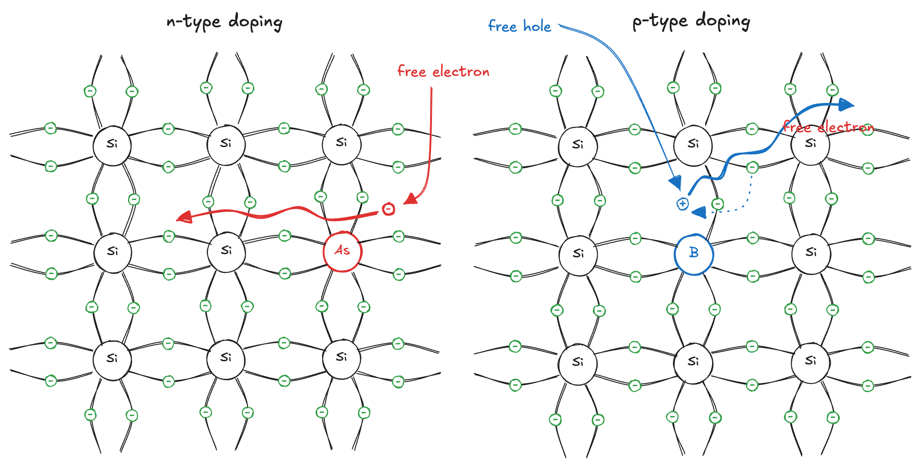
Semiconductor
Doping: tuning conductivity
n-type (e.g. As) → extra electron → free negative charge
p-type (e.g. B) → missing electron → hole behaves like positive charge
➡️ By adjusting dopants, silicon’s conductivity can vary over many orders of magnitude → basis for diodes and transistors

Slide 15
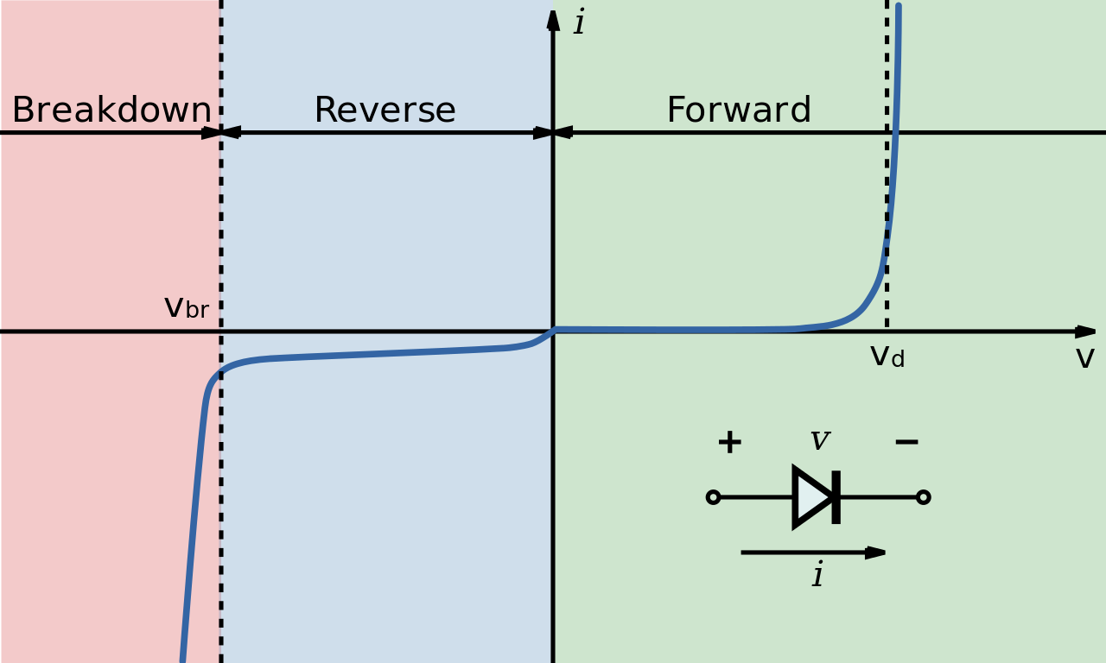
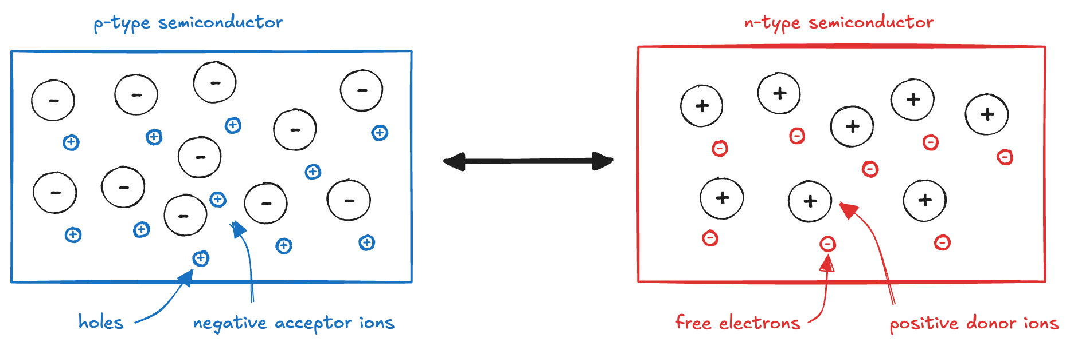
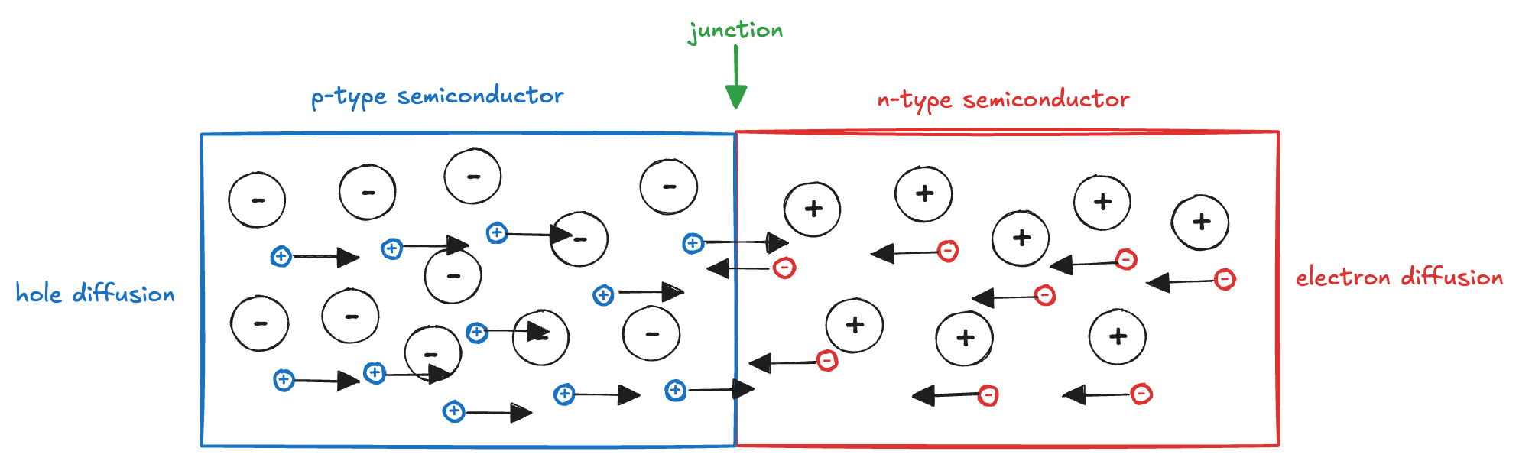
p-n junction (1)

Slide 16
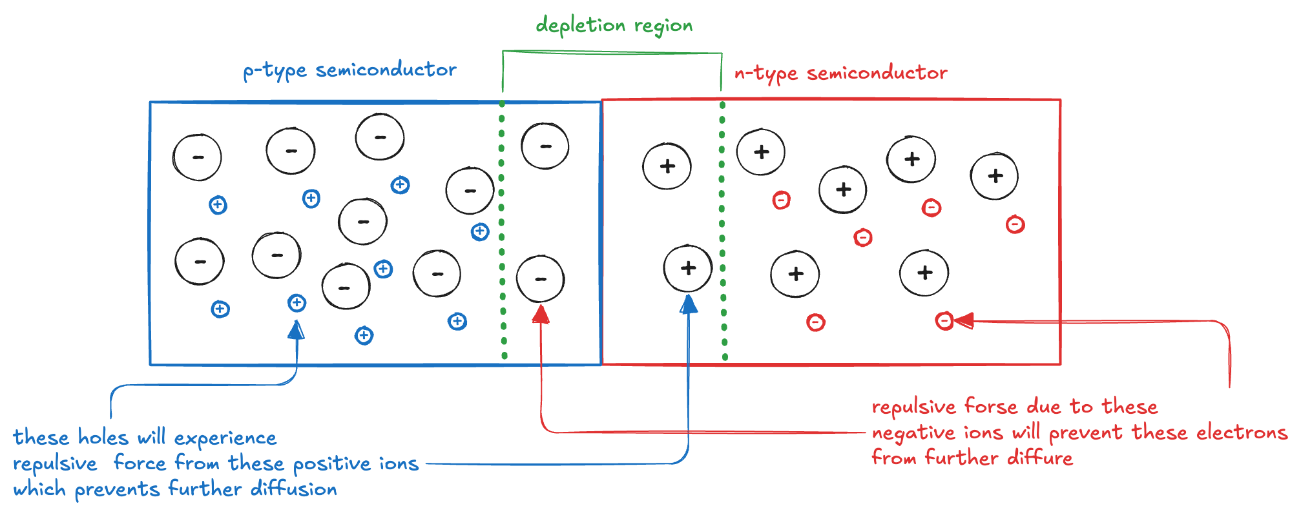
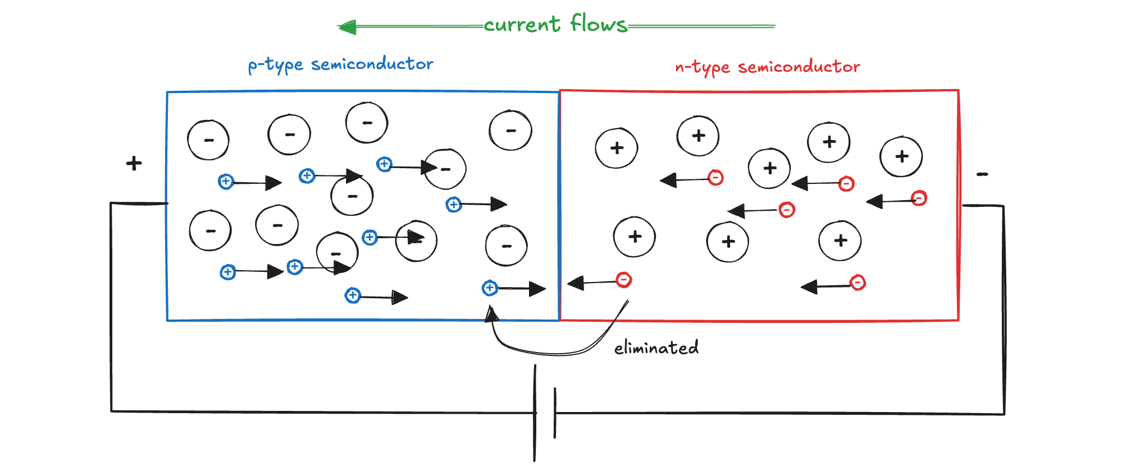
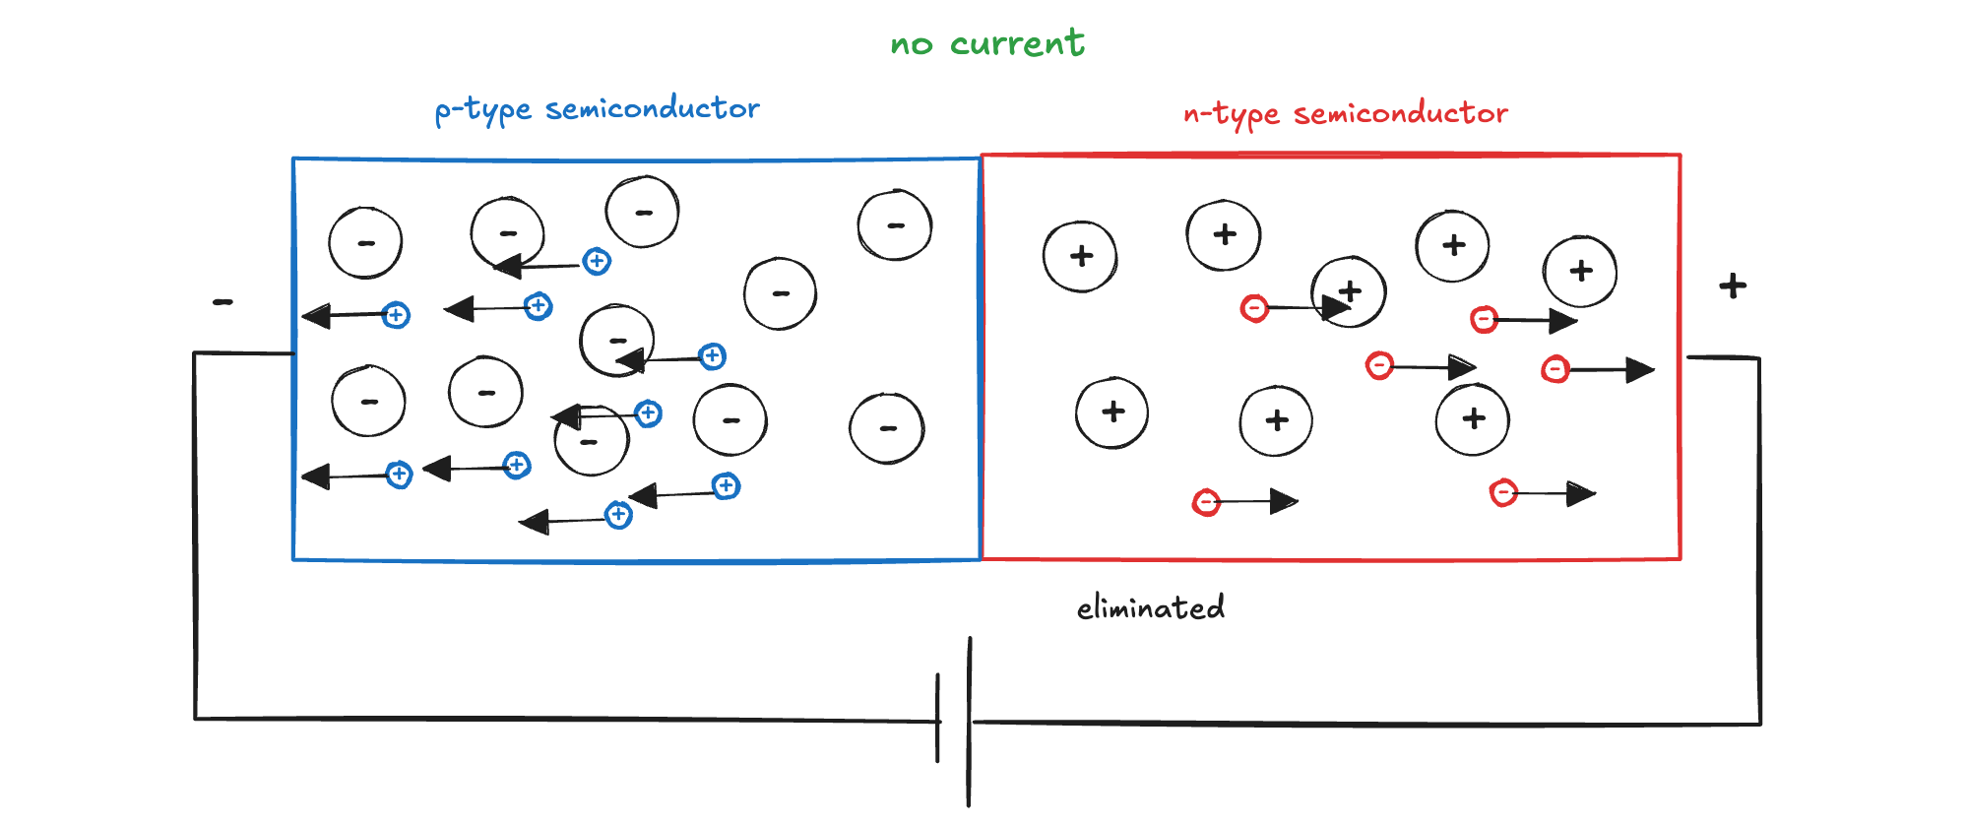
p-n junction (2)

Slide 17
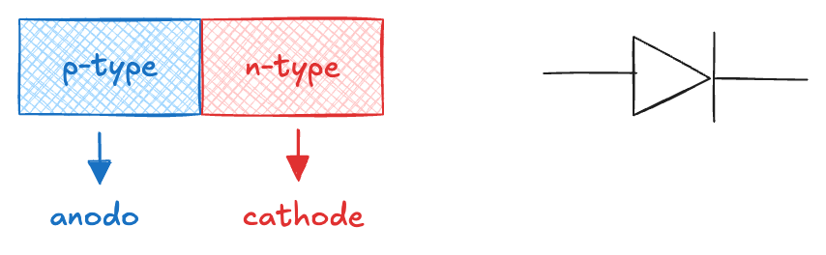
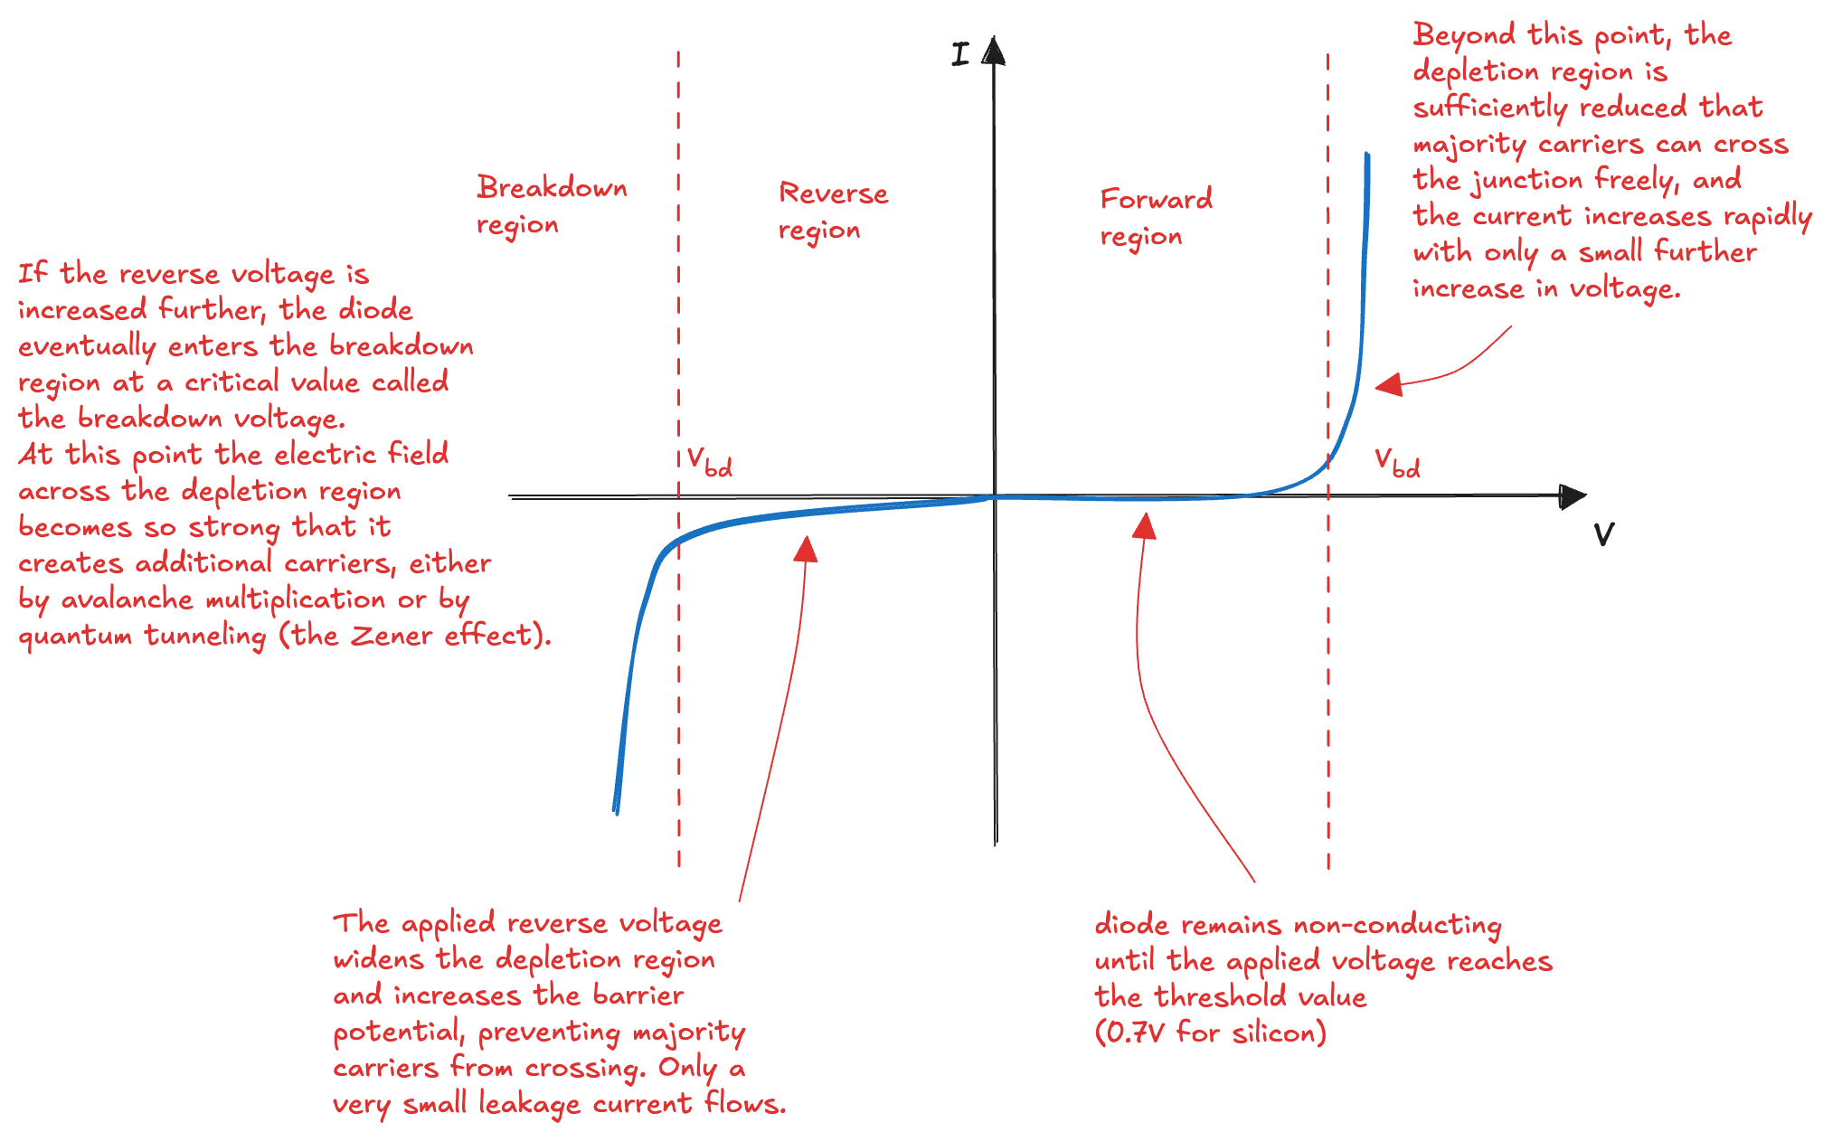
Diode

Slide 18
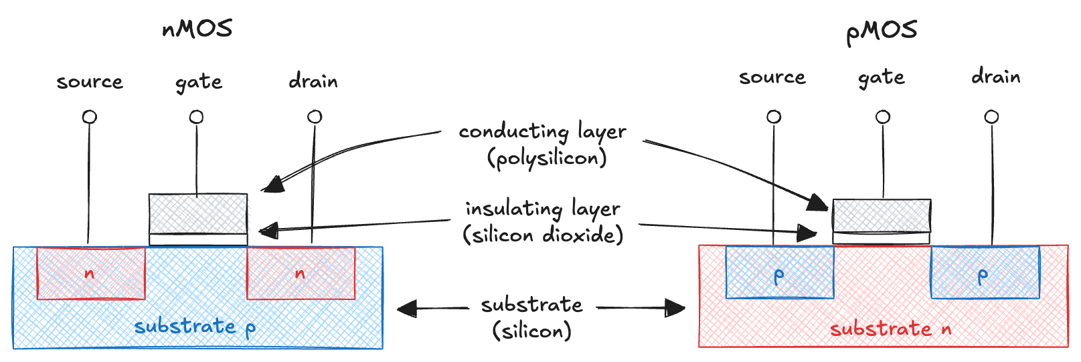
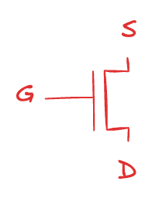
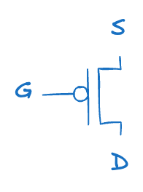
MOS Transistors (1)
MOSFET (Metal–Oxide–Semiconductor Field-Effect Transistor) is a sandwich of several layers of conducting and insulating materials:
MOS behaves as a voltage-controlled switch in which the gate voltage creates an electric field that turns ON or OFF a connection between the source and drain

Slide 19
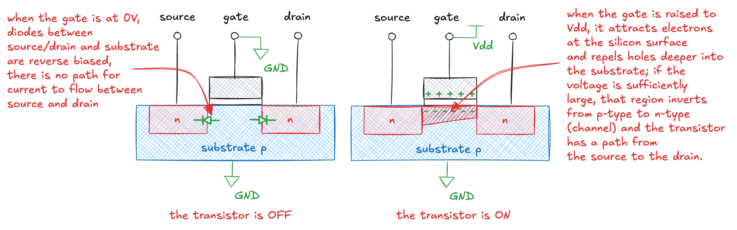
MOS Transistors (2)
Consider the nMOS:
pMOS works in just the opposite fashion
the substrate is tied to V_{dd}
when the gate is also at V_{DD}, the pMOS is OFF
when the gate is at GND, the channel inverts to p-type and the transistor is ON

Slide 20
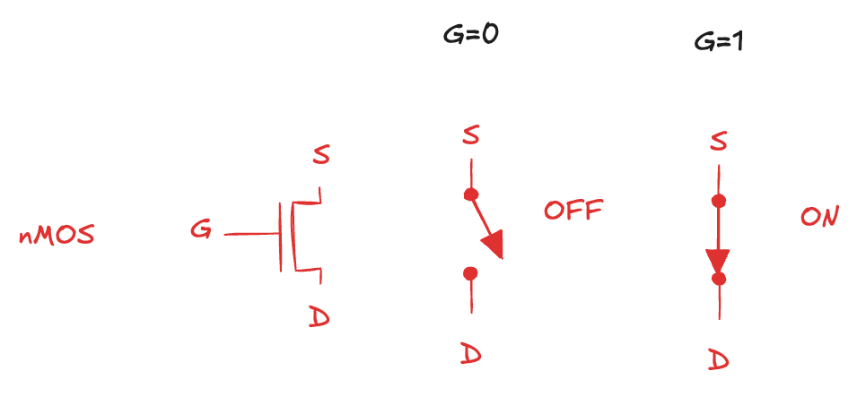
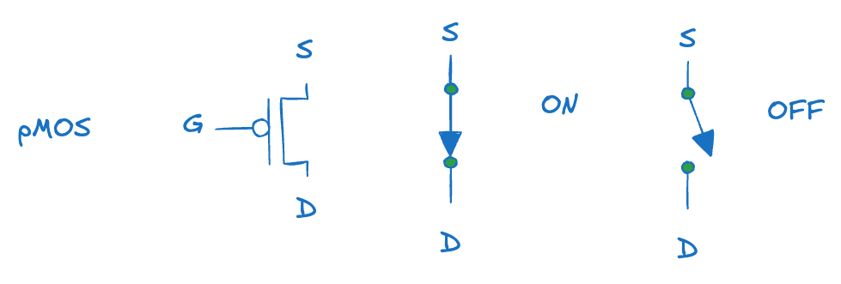
Switch models of MOS
CMOS give us two types of electrically controlled switches
Gate regulates current between source and drain
nMOS are OFF when the gate is 0 and ON when the gate is 1
pMOS are just the opposite
Unfortunately, MOS are not perfect switches
nMOS transistors pass 0 well, but pass 1 poorly
pMOS transistors pass 1 well, but 0 poorly

Slide 21
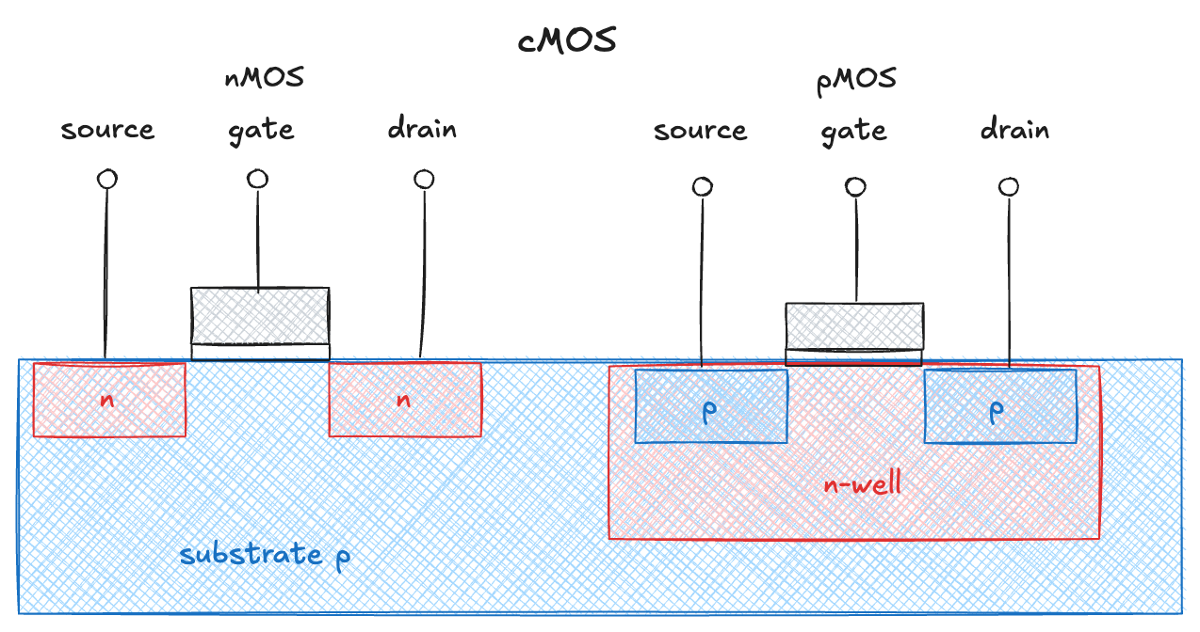
CMOS
To build digital logic efficiently, both nMOS and pMOS transistors must be fabricated on the same chip
Complementary MOS or CMOS

Slide 22
CMOS
To build digital logic efficiently, both nMOS and pMOS transistors must be fabricated on the same chip
Complementary MOS or CMOS

Slide 23
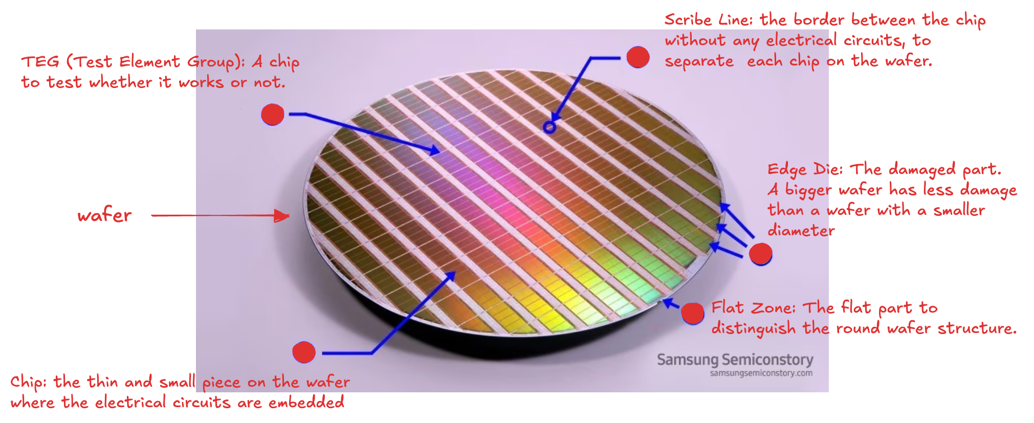
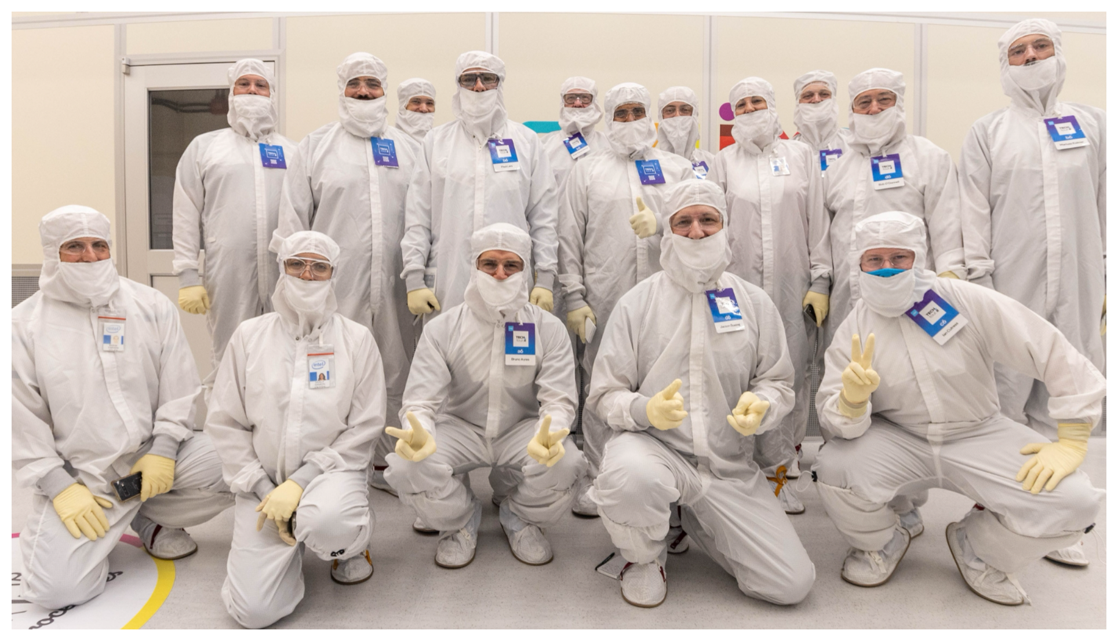
Building Integrated Circuits

Slide 24
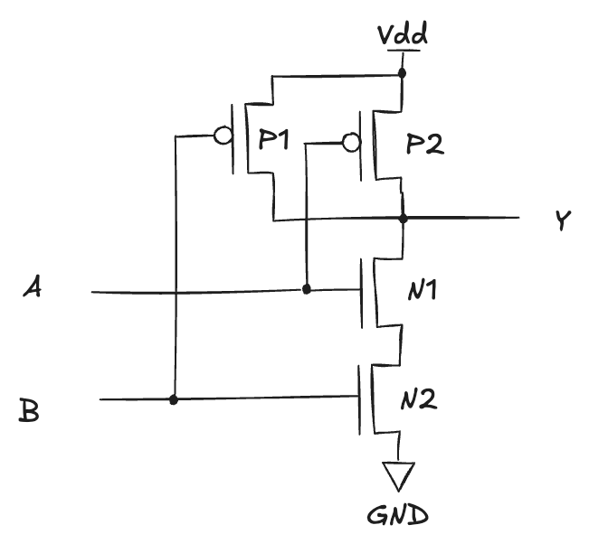
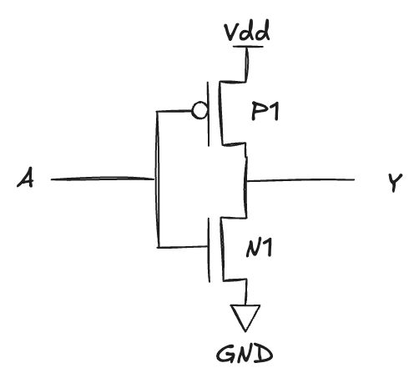
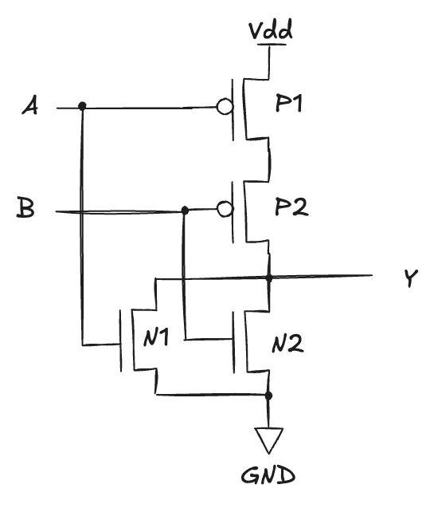
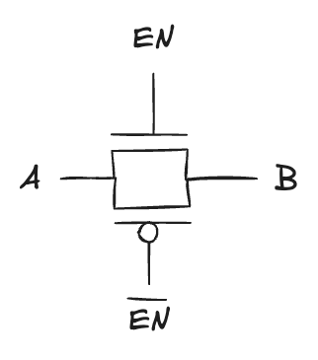
CMOS gates
NAND
NOT
NOR
Transmission Gate

Slide 25
Power consumption
The amount of energy used per unit time
Battery life of portable systems
a smartphone battery holds about 10 W-hr of energy, meaning that it could deliver 1W for 10 hours or 2W for 5 hours, and so forth
for your phone to last a full day, its average consumption should be under 1W
laptops typically have 50 to 100 W-hr batteries and consume under 10W in normal operation, of which the screen is a large fraction
Power is also significant for plugged systems
electricity costs money and emissions
the system will overheat if it draws too much power
Digital systems draw both dynamic and static power
dynamic: power used as signals change between 0 and 1
static: power used even when signals do not change, and the system is idle

